Slide 1
PIR-Tor: Scalable Anonymous Communication Using Private Information Retrieval
Prateek Mittal
University of Illinois Urbana-Champaign
Joint work with: Femi Olumofin (U Waterloo)
Carmela Troncoso (KU Leuven)
Nikita Borisov (U Illinois)
Ian Goldberg (U Waterloo)

Slide 2

Anonymous Communication
What is anonymous communication?
Allows communication while keeping user identity (IP) secret from a third party or a recipient
Growing interest in anonymous communication
Tor is a deployed system
Spies & law enforcement, dissidents, whistleblowers, censorship resistance
?
Routers

Slide 3



Tor Background
Directory
Servers
Trusted
Directory
Authority
List of servers?
Middle
Signed
Server list
(relay descriptors)
Exit
Guards
1. Load balancing
2. Exit policy

Slide 4
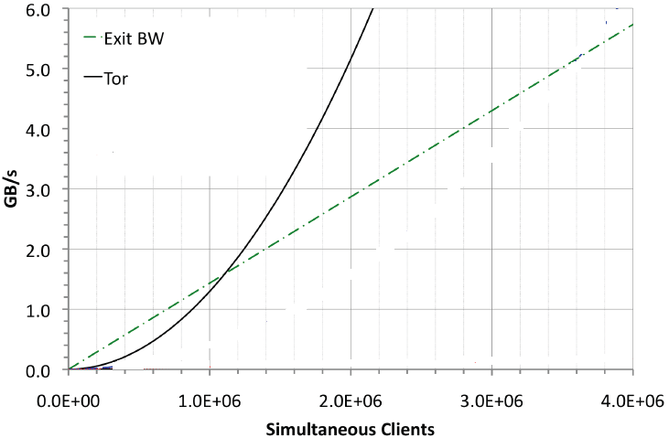
Performance Problem in Tor’s Architecture: Global View
Global view
Not scalable
Directory
Servers
List of servers?
Need solutions without global system view
Torsk – CCS09

Slide 5
Current Solution: Peer-to-peer Paradigm
Morphmix [WPES 04]
Broken [PETS 06]
Salsa [CCS 06]
Broken [CCS 08, WPES 09]
NISAN [CCS 09]
Broken [CCS 10]
Torsk [CCS 09]
Broken [CCS 10]
ShadowWalker [CCS 09]
Broken and fixed(??) [WPES 10]
Very hard to argue security of a distributed,
dynamic and complex P2P system.

Slide 6
Design Goals
A scalable client-server architecture with easy to analyze security properties.
Avoid increasing the attack surface
Equivalent security to Tor
Preserve Tor’s constraints
Guard/middle/exit relays,
Load balancing
Minimal changes
Only relay selection algorithm

Slide 7

Key Observation
Relay # 10, 25
Directory
Server
Need only 18 random middle/exit relays in 3 hours
So don’t download all 2000!
Naïve approach: download a few random relays from directory servers
Problem: malicious servers
Route fingerprinting attacks
Download selected relay descriptors without letting directory
servers know the information we asked for.
Private Information Retrieval (PIR)
Bob
10: IP address, key
25: IP address, key
10
25
Inference: User likely
to be Bob

Slide 8
Private Information Retrieval (PIR)
Information theoretic PIR
Multi-server protocol
Threshold number of servers don’t collude
Computational PIR
Single server protocol
Computational assumption on server
Only ITPIR-Tor in this talk
See paper for CPIR-Tor
R_{A}
A
R_{B}
B
R_{C}
C
Database
A
R_{A}
Database

Slide 9
ITPIR-Tor: Database Locations
Tor places significant trust in guard relays
3 compromised guard relays suffice to undermine user anonymity in Tor.
Choose client’s guard relays to be directory servers
Exit relay compromised:
Exit relay honest
At least one guard relay is honest
All guard relays compromised
Equivalent security to the current Tor network
Middle
Exit
Middle
Exit
Middle
Middle
Exit
Exit
Deny Service
End-to-end Timing Analysis
Guards
ITPIR does not provide privacy
But in this case, Tor anonymity broken
Guards
ITPIR guarantees user privacy
Guards
Guards

Slide 10
ITPIR-Tor Database Organization and Formatting
Middles, exits
Separate databases
Exit policies
Standardized exit policies
Relays grouped by exit policies
Load balancing
Relays sorted by bandwidth
Sort by
Bandwidth
Relay
Descriptors
m1
e1
m2
e2
m3
e3
Exit Policy 1
m4
e4
m5
e5
Exit Policy 2
m6
e6
m7
e7
Non-standard
Exit policies
m8
e8
Middles
Exits

Slide 11
ITPIR-Tor Architecture
Guard relays/
PIR Directory servers
Trusted
Directory
Authority
2. Initial connect
Download PIR database
3. Signed meta-information
18 PIR Queries(1 middle/exit)
5. 18 middle,18 PIR Query(exit)
6. PIR Response
m1
e1
4. Load balanced
index selection
m2
e2
m3
e3
m4
e4
m5
e5
m6
e6
m7
e7
m8
e8
Middles
Exits

Slide 12
Performance Evaluation
Percy [Goldberg, Oakland 2007]
Multi-server ITPIR scheme
2.5 GHz, Ubuntu
Descriptor size 2100 bytes
Max size in the current database
Exit database size
Half of middle database
Methodology: Vary number of relays
Total communication
Server computation

Slide 13
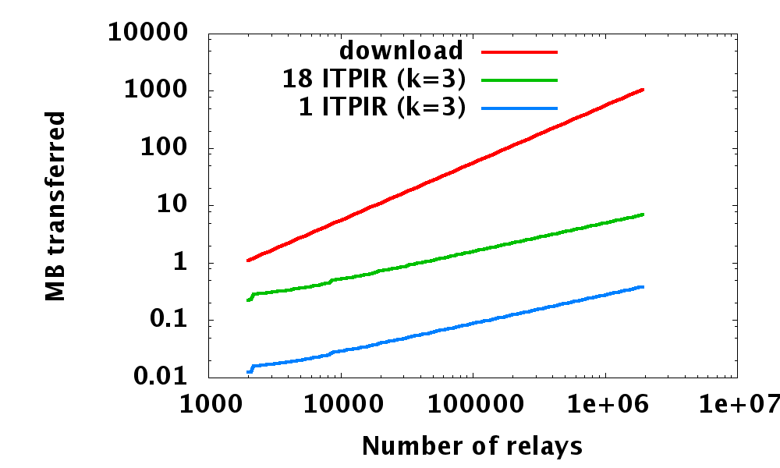
Performance Evaluation: Communication Overhead
Advantage of PIR-Tor becomes larger due to its sublinear scaling: 100x--1000x improvement
1.1 MB
216 KB
Current Tor network: 5x--100x improvement
12 KB

Slide 14
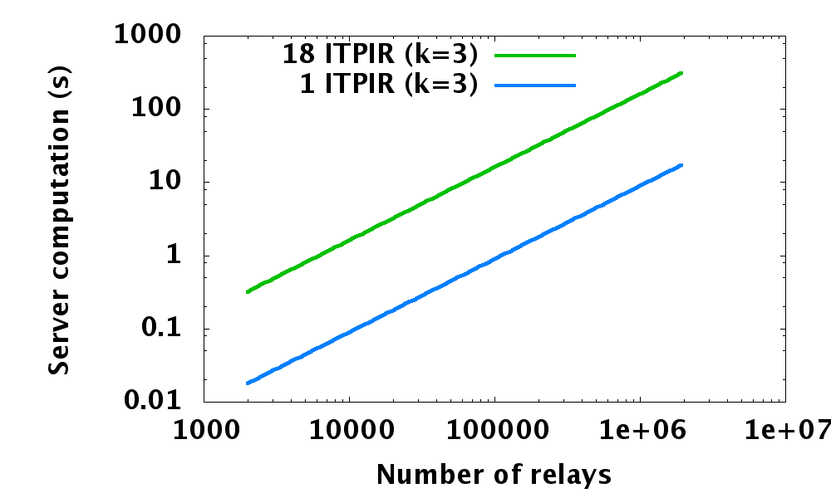
Performance Evaluation: Server Computational Overhead
100,000 relays: about 10 seconds (does not impact user latency)
Current Tor network: less than 0.5 sec

Slide 15
Performance Evaluation: Scaling Scenarios
Scenario |  |  | Tor Communication (per client) | ITPIR Communication (per client) | ITPIR Core Utilization
Explanation | Relay | Clients
Current Tor | 2,000 | 250,000 | 1.1 MB | 0.2 MB | 0.425 %
10x relay/client | 20,000 | 2.5M | 11 MB | 0.5 MB | 4.25 %
Clients turn relays | 250,000 | 250,000 | 137 MB | 1.7 MB | 0.425 %

Slide 16
Conclusion
PIR can be used to replace descriptor download in Tor.
Improves scalability
10x current network size: very feasible
100x current network size : plausible
Easy to understand security properties
Side conclusion: Yes, PIR can have practical uses!
Questions?

